Slide 1
Booklets Contents
            - Cover-Page (Front Page)
    - Product Overview
    - Product Idea (Problem & Solution)
    - Product Functions/Operations
    - Product Revenue Model
    - Product Future Expansion & Growth
    - Team Info
    - BackCover
Note: Please do not attach this page in your booklet.

Slide 2


Front Page
Home Delivery Service
“ Ethnic food from store to door ”
At Kloudrop, our passion is to make shopping easy, simple and safe for you and your family.
Nov 2021

Slide 3
about us
KLOUDROP is a market place where you can order ethnic grocery from multiple hyper/local stores.
We collect, consolidate and deliver.

Slide 4
Kloudrop Idea
Most people today want fast, reliable, and affordable home delivery—whether it's groceries, meals, or essentials. But traditional delivery services can be slow, expensive, or limited in coverage. At Kloudrop, we’ve made it easy. Our marketplace lets you order ethnic groceries from multiple hyper, local stores all in one place. We collect, consolidate, and deliver everything to your doorstep, saving you time and hassle. With Kloudrop, you get access to a wide range of authentic products, all delivered quickly and conveniently, without the need to visit each store separately.

Slide 5
Kloudrop Business
(Product Operations/Functions)
App/Web Platform: User-friendly interface for ordering groceries, meals, and essentials from local stores.
Smart Search & Discovery: AI-powered recommendations for ethnic foods, trending products, and nearby vendors.
Real-Time Tracking: Live GPS updates for orders, estimated delivery times, and courier communication.
Flexible Delivery Options: Scheduled or instant delivery (e.g., 30-minute express, same-day).
Loyalty Programs: Discounts for frequent users or referrals.
Vendor Onboarding: Seamless sign-up for local ethnic markets, grocery stores, and restaurants.
Analytics Dashboard: Sales performance, customer demographics, and demand forecasting.
Dynamic Pricing & Promotions: Tools for merchants to run flash sales or bundle deals.

Slide 6
Kloudrop Business
(Product Operations/Functions)
(Product Courier (Delivery Fleet) Management)
Gig-Based Driver Network: Independent couriers sign up via an app, with background checks for safety.
Route Optimization: AI-driven logistics to minimize delivery time and fuel costs.
Earnings & Incentives: Transparent pay structure (per delivery + tips) and surge pricing during peak demand.
Training & Support: Guidelines for handling ethnic groceries (e.g., temperature-sensitive items).

Slide 7
Kloudrop Business
(Product Operations/Functions)
(Technology & Logistics)
Matching Algorithm: Automatically pairs orders with the nearest available courier.
Smart Warehousing (Optional): Micro-fulfillment hubs for high-demand ethnic products.
Multi-Language Support: Breaks barriers for non-English-speaking merchants/customers.
API Integrations: Partnerships with POS systems (e.g., Square, Toast) for smooth order sync.

Slide 8
Kloudrop Business
(Revenue Model)
Commission Fees: 10–20% per transaction from merchants (lower than giants like Uber Eats).
Delivery Fees: Small customer fee (waived for subscriptions).
Subscription Plans: Monthly memberships for unlimited free deliveries.
Ads & Promotions: Featured listings for local businesses.

Slide 9
Kloudrop Business
(Market Expansion & Growth)
Ethnic-First Strategy: Focus on underserved communities (e.g., Hispanic, Asian, Halal markets).
Partnerships: Collaborate with cultural festivals, influencers, and immigrant associations.
White-Label Solutions: License Kloudrop’s tech to regional grocery chains.

Slide 10
team
The Kloudrop team has extensive knowledge and experience and all the necessary entrepreneurial qualities and business disciplines to develop and position the brand.
Pictrue
Picture
Piture
name
name
name

Slide 11
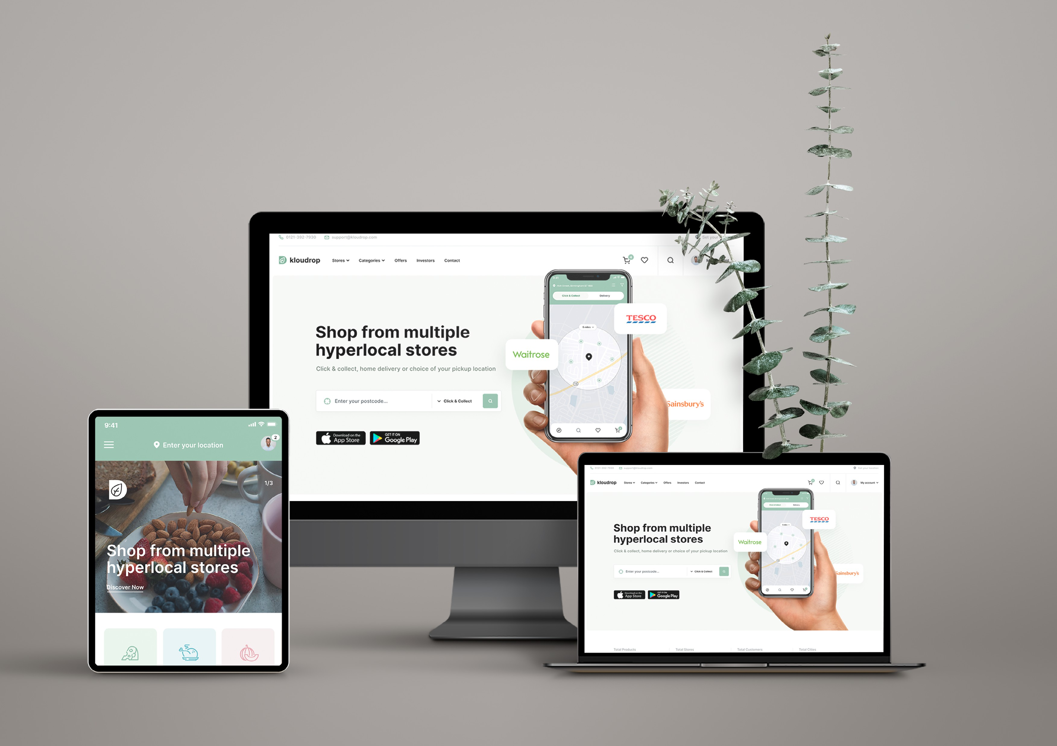




Back-Cover

